Slide 1
Motivating Introductory Computing with Student-Driven Datasets
Austin Cory Bart
Preliminary Exam
October 5th, 2015
Knowledge Works II, Room 2225

Slide 2
Outline
Problem
Theory
Motivation
Learning
Literature Review
Prior Work
Research Questions
Technology
Motivation

Slide 3



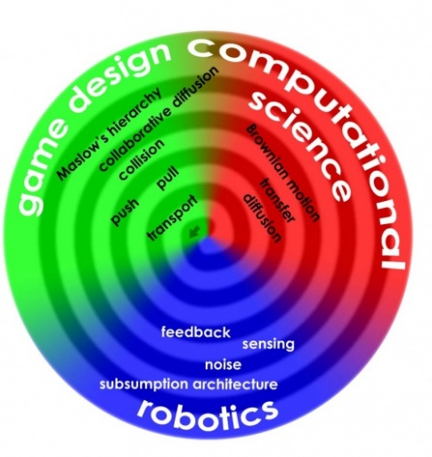

Computer Science For All

Slide 4
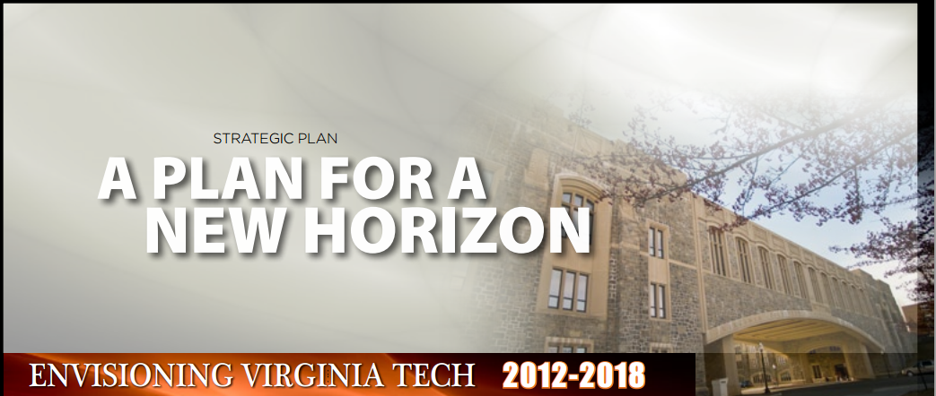
Virginia Tech
“To this end, Virginia Tech will comprehensively evaluate and modify the current Curriculum for Liberal Education to … incorporate computational thinking and informatics/digital fluency as basic skills for all students, thereby enabling our students to be engaged citizens and life-long learners.”

Slide 5


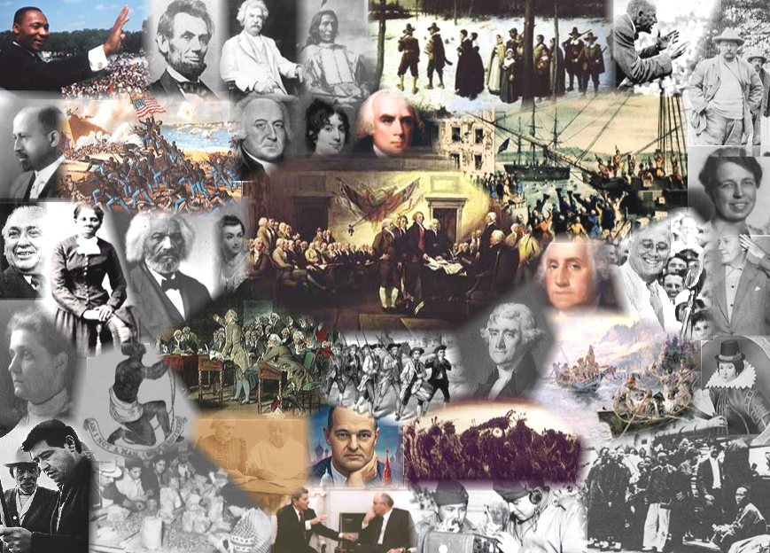
Diverse Majors
… with Rich Knowledge
English
Biological Sciences
Animal Sciences
Education
Theater Arts
History
Building Construction

Slide 6







(1) No Prior Background
“Conditional”
“Recursion”
“Abstract Data Type”
“Map-Filter-Foldr”
“Balanced Binary Tree”
“Fibonacci”
“Function”

Slide 7

(2) Self-efficacy

Slide 8

(3) Why care about learning Computing?

Slide 9
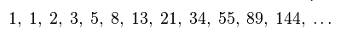
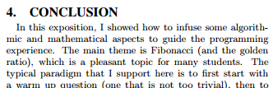
Contexts: Math and Business
Pure Math (e.g., Fibonacci)
Saad Mneimneh. 2015. Fibonacci in The Curriculum: Not Just a Bad Recurrence. In Proceedings of the 46th ACM Technical Symposium on Computer Science Education (SIGCSE '15). ACM, New York, NY, USA, 253-258.

Slide 10
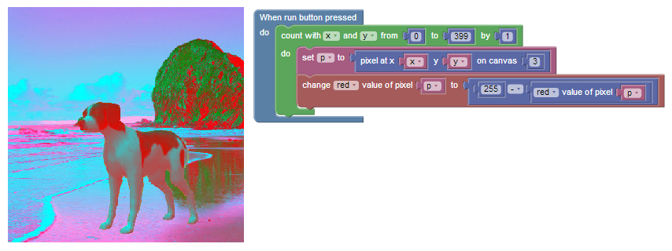

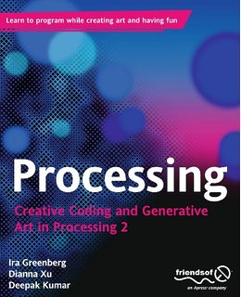


Fun to the rescue!

Slide 11


But…
Problem | Media Comp
Relatable
Successful
Useful
Mark Guzdial and Allison Elliott Tew. 2006. Imagineering inauthentic legitimate peripheral participation: an instructional design approach for motivating computing education. In Proceedings of the second international workshop on Computing education research (ICER '06). ACM, New York, NY, USA, 51-58. DOI=10.1145/1151588.1151597 http://doi.acm.org/10.1145/1151588.1151597

Slide 12
Learning Theory
Motivation
Learning

Slide 13
MUSIC Model of Academic Motivation
Students are more motivated when they perceive that:
they are eMpowered,
the content is Useful,
they can be Successful,
they are Interested, and
they feel Cared for by others in the learning environment
B. D. Jones. Motivating students to engage in learning: The MUSIC model of academic motivation. International Journal of Teaching and Learning in Higher Education, 21(2):272–285, 2009.

Slide 14
Motivation and Engagement
Motivation
Outcomes
Learning
Persistence
Proactivity
Attendance
…
eMpowerment
Usefulness
Success
Interest
Engagement

Slide 15
Situated Learning
Lave & Wenger
Contextual learning experiences

Slide 16
Situated Learning Framework Choi & Hannafin
Context
Content
Assessments
Assessments
Assessments
…
…
Scaffolds
Scaffolds
Scaffolds
Scaffolds

Slide 17
Situated Learning vs. Motivation
Situated Learning Component: | Context | Content | Facilitations | Assessment
Example | "Game Design" | "For Loops" | Blocks-based environment, teaching assistants, etc. | Exams, performance review, code review
eMpowerment | Am I restricted by the context to explore what I want? | Do I have control over the depth/breadth/direction of what I am learning? | Do these scaffolds let me accomplish things I couldn't? | Can I explore my limitations and successes in this assessment?
Usefulness | Is this situated in a topic that's worth learning? | Is the content itself worth learning? | Do these scaffolds let me learn enough to still be useful? | Do I feel that performing well on the assessment is important?
Success | Do I believe I can understand this context? | Do I believe I can understand this material? | Do these scaffolds hinder me or help me? | Can I suceed at this assessment?
Interest | Is this situated in something I find boring/interesting? | Is the material inherently interesting? | Do the scaffolds support my interest in the activity or detract from the experience? | Am I interested in the assessment experience?
Caring | Does the context give opportunities for the instructor and peers to show they care? | Does the content give opportunities for the instructor and peers to show they care? | Do the scaffolds give opportunities for the instructor and peers to provide support? | Does the assessment give opportunities for the instructor and peers to show they care?

Slide 18
Situated Learning vs. Motivation
Situated Learning Component: | Context | Content | Facilitations | Assessment
Example | "Game Design" | "For Loops" | Blocks-based environment, teaching assistants, etc. | Exams, performance review, code review
eMpowerment | Am I restricted by the context to explore what I want? | Do I have control over the depth/breadth/direction of what I am learning? | Do these scaffolds let me accomplish things I couldn't? | Can I explore my limitations and successes in this assessment?
Usefulness | Is this situated in a topic that's worth learning? | Is the content itself worth learning? | Do these scaffolds let me learn enough to still be useful? | Do I feel that performing well on the assessment is important?
Success | Do I believe I can understand this context? | Do I believe I can understand this material? | Do these scaffolds hinder me or help me? | Can I suceed at this assessment?
Interest | Is this situated in something I find boring/interesting? | Is the material inherently interesting? | Do the scaffolds support my interest in the activity or detract from the experience? | Am I interested in the assessment experience?
Caring | Does the context give opportunities for the instructor and peers to show they care? | Does the content give opportunities for the instructor and peers to show they care? | Do the scaffolds give opportunities for the instructor and peers to provide support? | Does the assessment give opportunities for the instructor and peers to show they care?

Slide 19
Content
Computational Thinking
CS-1
CS-2
CS-3
Programming
Iteration
Decision
Software Engineering
Object-Oriented Programming
Data Structures
Abstraction
Program Analysis
Social Impacts

Slide 20
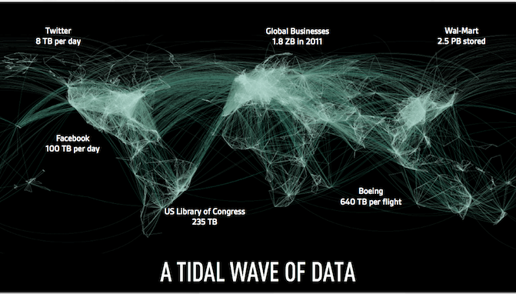
Why are we teaching computing?

Slide 21
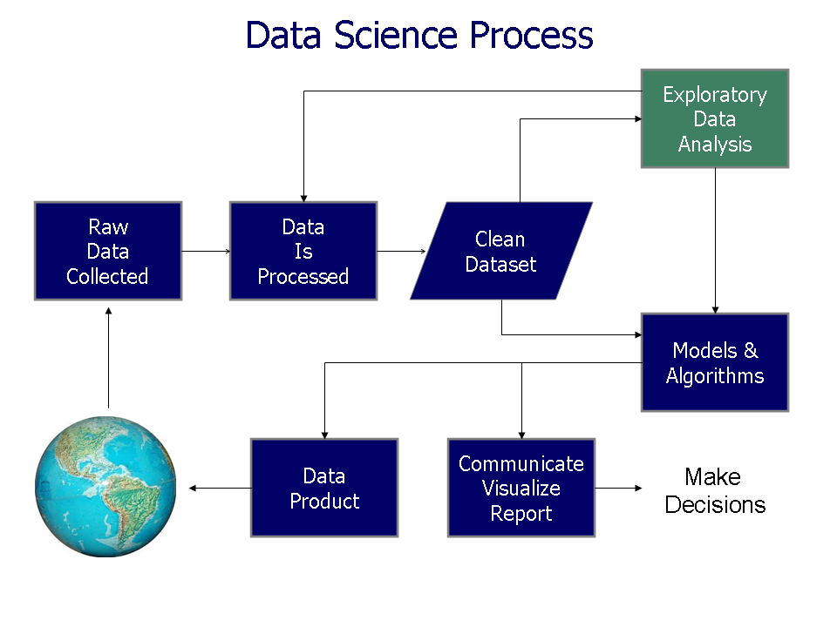
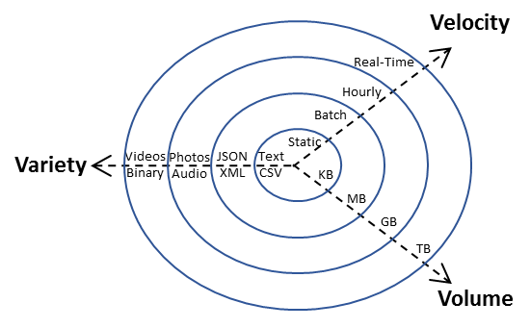
Big Idea: Real-World Data

Slide 22
Planning a Motivational Context
Component | … Via
eMpowerment | Freedom to choose datasets
Usefulness | Direct relevance to discipline
Success | Non-trivial, but not difficult to use
Interest | Direct relevance to interests
Caring | Opportunities to discuss

Slide 23
Prior Work

Slide 24
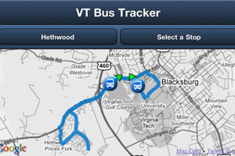


VT Bus Tracking API
Dr. Eli Tilevich
Dr. Cliff Shaffer

Slide 25

RealTimeWeb – Real-time data

Slide 26



RealTimeWeb – Secret Sauce
Client Library
Online
Web Service
.getData()
[.searchBusinesses()]
[.getEarthquakes()]
[.getBuses()]
[...]
Local Cache File

Slide 27
Cache Files = Sophisticated Snapshots
getEarthquakes() => [ <raw usgs data>, <raw usgs data>, …]
june_18_2013.json
Call | Returns
#1 | 5 earthquakes
#2 | 2 earthquakes
#3 | 7 earthquakes
… | …

Slide 28
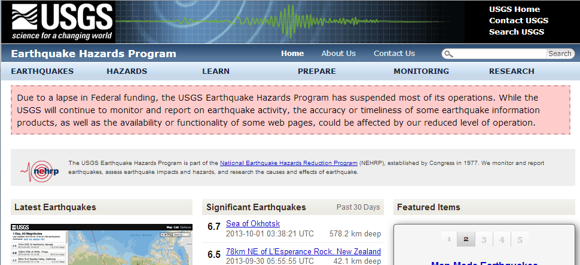
So many Points of Failure!
U.S. Geological Survey, 2013, Earthquakes Hazards Program available on the World Wide Web, accessed [October 7, 2013], at URL [http://earthquake.usgs.gov/].

Slide 29




Three Components
Client Libraries
Curated Gallery
Library Generator

Slide 30




Gallery - Initial Offering
Earthquakes
Weather
Stocks
Reddit
Magic the Gathering

Slide 31



Client Library Building
API Spec
Jinja2 Templates

Slide 32
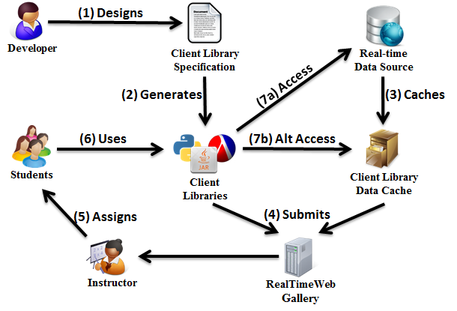
Complete Picture

Slide 33
Deployment
Semester | School | Course
Spring 2013 | Virginia Tech | CS-2
Fall 2013 | University of Delaware | CS-1
 | Virginia Tech | CS-2
 | Virginia Tech | CS-3
Spring 2014 | Virginia Tech | CS-2

Slide 34
Success
SIGCSE Publication
SPLASHE Conference Talk
SIGCSE RTW Workshop: 2014, 2015
Eli Tilevich, Clifford A. Shaffer, and Austin Cory Bart. 2014. Creating stimulating, relevant, and manageable introductory computer science projects that utilize real-time web-based data (abstract only). In Proceedings of the 45th ACM technical symposium on Computer science education (SIGCSE '14). ACM, New York, NY, USA, 743-743. DOI=10.1145/2538862.2539002
Austin Cory Bart, Eli Tilevich, Simin Hall, Tony Allevato, and Clifford A. Shaffer. 2014. Transforming introductory computer science projects via real-time web data. In Proceedings of the 45th ACM technical symposium on Computer science education (SIGCSE '14). ACM, New York, NY, USA, 289-294. DOI=10.1145/2538862.2538941
A. C. Bart, E. Tilevich, C. A. Shaffer, T. Allevato, S. Hall, Using Real-Time Web Data to Enrich Introductory Computer Science Projects, Splash-E '13, Indianapolis, Indiana. October 26-31, 2013.

Slide 35
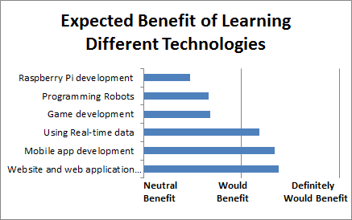
CS-1 results

Slide 36

“V2”: CORGIS
Collection of Real-time, Giant, Interesting datasetS

Slide 37
Goals
Expand to other dimensions of “Big”-ness
Expand number of libraires
Deeper evaluation

Slide 38
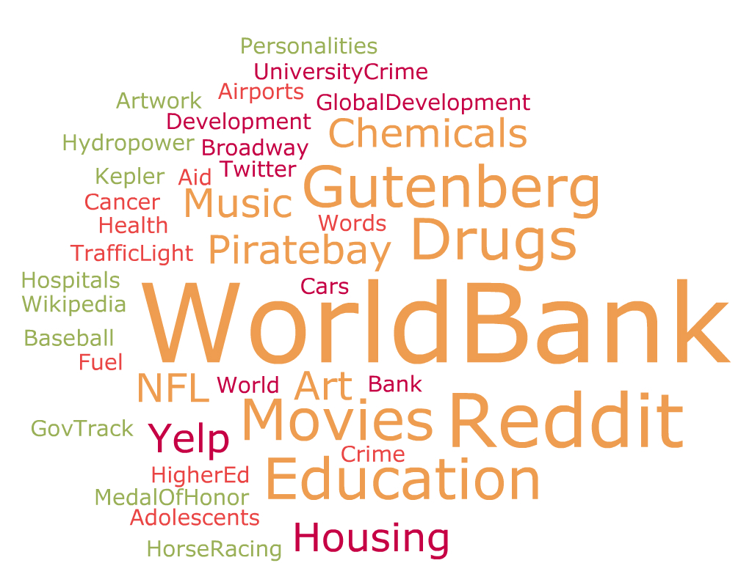
Datasets

Slide 39
High Volume (Sampling)
Client Library
(get-weather ...)
[.searchBusinesses()]
[.getEarthquakes()]
Large Data Source
Internal Data
[.get_stocks()]
[...]

Slide 40

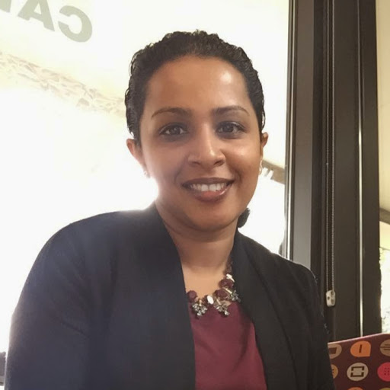
Computational Thinking Course
Dr. Dennis Kafura
Bushra Chowdhury
F13 CS-6604 Grad Seminar
F14 CS-2984 First offering
S15 CS-2984 Second offering
F15 CS-2984 Third offering

Slide 41
Course Overview
Course Topic
Survey
Introduction
1 Week
Computational Modelling
NetLogo
3 Weeks
Algorithms
Blockly (Python)
3 Weeks
Survey
Big Data
IDLE (Python)
4 Weeks
Conclusion
Survey
1 Week

Slide 42
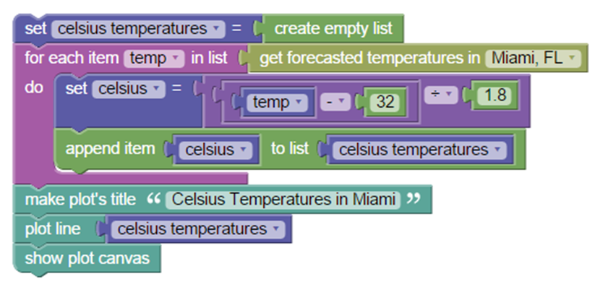
Data Science Blocks

Slide 43
Final Project
Authentic Assessment
Using a dataset
Make visualizations
Answer a question
Present

Slide 44
Demographics
Fall 2014: 26, 30% women
Spring 2015: 35, 60% women
Majors: Science, Art, Engineering, Agriculture, etc.

Slide 45
Agree
Disagree

Slide 46
Helpfulness to Learning by Resource
Usefulness to Long-term Goals by Resource
(Self-report, N=20)
Interestingness of Learning Resource

Slide 47
How much stakeholders care about you
(Self-report, N=20)

Slide 48
Contexts (S16, N=35)

Slide 49
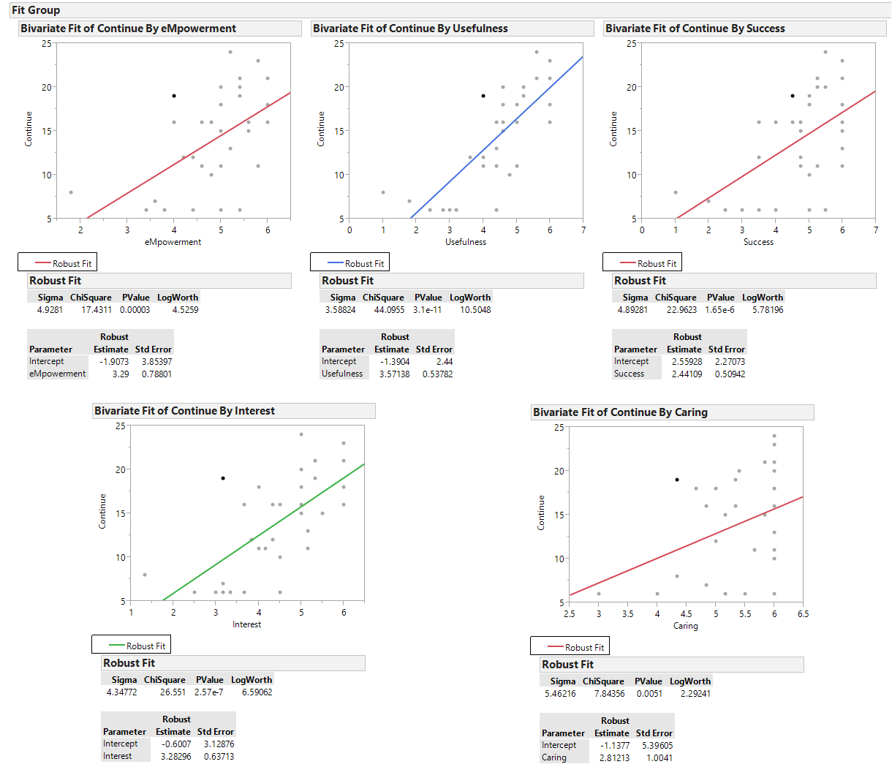
MUSIC vs. Continuation

Slide 50
Spring 2015, Qualitative Results
Interest
Usefulness
Empowerment
NetLogo (-10, +2)
Python (+8)
Blockly (+10, -8)
Project (+7)
Data Analysis (+7)
CT (+7)
Python (+6)
Coding (+5)
Project(+14)
Overall(+6)

Slide 51

Students’ Perception Remains Mysterious
Real-world, Real-time, Big Data related to your major and interests, of your choosing!
Big Data!
Computing!
My choice!
Real world!
I hate college!

Slide 52
Diminishing Returns
Motivation
Complexity

Slide 53
Research Questions
RQ1: Technological Scaffolding Questions
RQ2: Motivational Context Questions

Slide 54
RQ1 - Technology
What facilitations support the use of Data Science as an introductory context to provide motivation?
CORGIS Library Architecture
Gallery
Library Generator

Slide 55
RQ1.1 – CORGIS Library Architecture
“How can we build and maintain a plethora of divergent datasets, that still ensure students have a uniform experience working with their dataset even in the presence of divergent hardware and datasets? “
Create a new architecture that simplifies the creation of dataset libraries (whether web-based or local), while being highly maintainable to developers and performant for students.
Library Maintenance
Documentation
Divergent Hardware

Slide 56
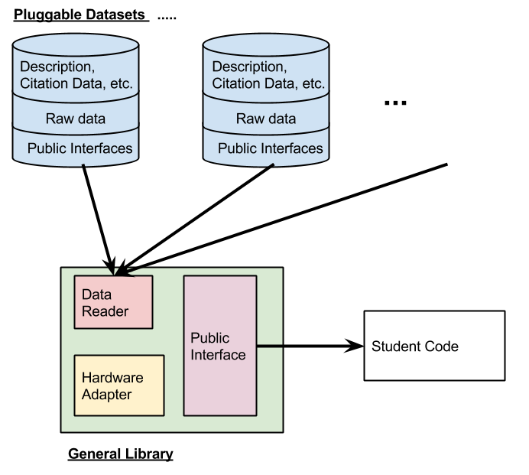

Python (/Racket)
> pip install datasets
Download “datasets.py”
datasets.py
Etc.
weather.db
reddit.db
movies.db
from datasets import weather
weather.get_temperature(‘Blacksburg’)

Slide 57

Java
Java Builder
weather.db
weather.java
> jar …
weather.jar
datasets.java

Slide 58
Dataset
Metadata
Version, Authorship
Citation, Social Impacts
Structure
Interface
Adaptable Queries
Documentation
Data
Stored data via SQL Queries (static)
Mocking rules via constraints (dynamic)
Web API spec (dynamic, web-based)

Slide 59
API Spec
URL: http://forecast.weather.gov/?CityName=Blacksburg&type=json
Verb: GET
Parameters: <“City” : String>
Return: <int> data.weather[0].temperature

Slide 60
Raw Data
“SELECT temperature FROM forecasts WHERE city=‘{city}’ LIMIT {performance_level}”

Slide 61
Mocking Rules
“get temperature”
Returns an int
In the range of “60-80”, normally distributed
“get earthquake”
Returns a lat/long
In the [-180-180, -180-180], normally distributed

Slide 62
Hardware Adaption
Based on previous execution
Sampling

Slide 63
RQ1.2 – CORGIS Builder Architecture
How can we lower the barrier for instructors and domain experts to transform a data source into a classroom ready resource?
An evolution of the RTW Online Building tool to make it even easier to prepare a JSON/CSV data source into a library.
Format conversion (JSON, CSV, TXT)
Restructuring
Caching Strategy

Slide 64
Data Cache Editing (“VCR Recording”)
EditableCache ec =
new EditableCache();
StickyWebRequest request =
yelp.searchRequest(term, location);
.setDataSource(FileInputStream)
request.getHashedRequest()
.addData(request, data)
request.execute().asText()
.saveToStream(FileOutputStream)

Slide 65
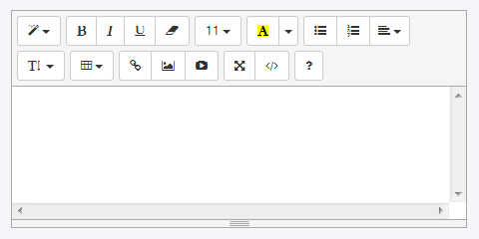
High-level concept
Metadata
Interfaces
Get Temperature
City : String
Weather data comes from the National Weather Service and is used to forecast blah blah blah blah blah blah blah blah
Web API Spec
Mocking Rules
Raw Data
Download
Single file .py
Datasets.py Archive
Java Jar
Single file .rkt
Datasets.rkt Archive
BlockPy Library

Slide 66
RQ 1.3 – CORGIS Gallery
How can we support students’ and instructors discovery of their data source?
An enhancement to the RTW Online Gallery to make it more interactive and guiding for students to discover their datasets
Bifurcated for user roles
Searchable, Browseable
Documentation

Slide 67
RQ2 - Impact
How do the student-driven data context and scaffolds impact students’ motivation and engagement?
Motivation
Outcomes
Learning
Persistence
Proactivity
Attendance
…
eMpowerment
Usefulness
Success
Interest
Engagement

Slide 68
RQ 2.1 - Motivation
What is the impact on motivation?
Measured through self-reported quantitative surveys and qualitative interviews

Slide 69
Separate Course Components
Motivational Components
“I believe that I will have freedom to explore my own interests when I…” | eMpowerment
“I believe it will be useful to my long-term career goals to…” | Usefulness
“I believe I will be successful in this course when I…” | Success
“I believe it will be interesting to…” | Interest
“I believe that my instuctors and peers will care about me when I…” | Caring
Course Component
"... learn to write computer programs" | Algorithms Content
"... learn to work with abstraction" | Abstraction Content
"... learn about the social impacts of computing" | Social Ethics Content
"... work with real-world data related to my major" | Data Science Context
"... work with my cohort" | Collaboration Facilitation
Likert
Strongly Disagree
Disagree
Somewhat Disagree
Neither Agree nor Disagree
Somewhat Agree
Agree
Strongly Agree

Slide 70
Open-ended Qualitative Questions
“So far, what parts of the course seem particularly _ to you?”
Hard or easy
Interesting or boring
Useful or useless
Empowering or Limiting
“So far, how have your instructors or your classmates shown that they care or don’t care about you?”

Slide 71
Specific Survey Questions
What are students initial, self-reported attitudes and expectations entering the course?
How does students’ motivation change over the course of the semester?
What course components are particularly effective or not effective at providing motivation?
Do different course components affect different aspects of motivation in different ways (e.g., scaffolds would be expected to affect success, but do they also have an impact on sense of usefulness or interest?)

Slide 72
Interview Protocol
Explanation of Goal
Students’ status
Dataset questions
In general
Empowerment
Usefulness
Success
Interest
Caring
Open-ended response

Slide 73
Interview questions
What aspects of the dataset experience affected the students’ motivation?
Do the students understand how to use the dataset?
Do students generally expect the dataset to be authentic and relate to the real-world?
How do students view the data science context in comparison to the rest of the course?

Slide 74
RQ 2.2 - Engagement
What is the impact on engagement?
Measured through observable outcomes and some self-reported information

Slide 75
Engagement Outcomes
Attendance | Numeric value indicating percentage of classes attended
Procrastination | Numeric value indicating percentage of assignments submitted late
Assistant Observations | Two numbers on 1-4 scale given by students’ teaching assistant to estimate their motivation and ability
Course Performance | Final course grade
Project Performance | Final project grade (assessed via rubric by instructor and classmates)
Intent to Continue | 7-point likert question in survey about whether students intend to continue their computing education (formally or informally)

Slide 76
Work and Publication Plan
Semester | Course Stats | Technology | Publications
Fall 2015 | N=35 | New CORGIS Architecture | SIGCSE’16 Paper on BlockPy+CORGIS
Spring 2016 | N=50+ | New CORGIS Gallery
Summer 2016 |  | New CORGIS Builder | TOCE: Instructional Design
Fall 2016 | N=50+ |  | SIGCSE’17: CORGIS TOCE: CORGIS
Spring 2017 | N=50+ |  | Dissertation

Slide 77
Why not Instructional Design

